Slide 1

Kebijakan dan Strategi untuk mewujudkan Manajemen Adaptif di Perguruan Tinggi
Titi Savitri Prihatiningsih
Departemen Pendidikan Kedokteran dan Bioetika
Fakultas Kedokteran, Kesehatan Masyarakat dan Keperawatan
Universitas Gadjah Mada

Slide 2




Topik Presentasi
Tantangan PT Indonesia
Tantangan 2045
Transformasi Pendidikan Tinggi
Manajemen Adaptif pada Perguruan Tinggi

Slide 3
Topik Presentasi
Tantangan PT Indonesia

Slide 4
Tata Kelola
Otonomi
Akses
Pemerataan
Mutu
Internasionalisasi
Logli, C. (In Press)

Slide 5
Topik Presentasi
Tantangan 2045

Slide 6
Bonus Demografi
Jumlah Pengang-guran
MEA
GATTS
Knowledge Economy
Teknologi Digital
Micro-credential
Just-in Time Education
Individua-lized learning
MEME
Modular System

Slide 7
Transformasi yang diperlukan
Job creator with balanced entrepreneurial mindset
Focus on outcomes
University autonomy
All stakeholders have shared responsibilities for higher education resources
Technology enabled-innovations to deliver and tailor educations for all students
Higher Learning Institutions
Job Seekers
Focus on education
Focus on inputs
Highly centralized
Reliance on government resources
Mass production delivery model
Separation of private and public institutions

Slide 8
Perlu redefinisi/reformasi:
Proses pembelajaran
Penilaian dan asesmen pendidikan
Tata kelola perguruan tinggi
Ekosistem inovasi
Microcredentials
Investment pada digital technology
Restrukturisasi peran dan fungsi kementerian pendidikan
Penguatan peran kementerian2 lain, pemangku kepentingan lain
Kerangka kualifikasi nasional
Jenis, jenjang dan jalur pendidikan
program studi
mata kuliah
kurikulum
sistem kredit semester
Akreditasi
Principle-based standards

Slide 9
Four Learning Pathways https://www.fierceeducation.com/pedagogy/future-higher-education-four-models-moving-toward-2030
Tamagotchi: Here, the study program offers basic, comprehensive preparation for subsequent employment, with the university functioning as a closed ecosystem that supports and guides students as they pursue a course of study. This model is well-suited to people who go directly from school to university or college.
Jenga: In this model, the first-degree program offers a solid foundation of knowledge and competences. It can take the form of a shortened study program. The curriculum builds on this foundation and is constantly expanded by the student through new learning blocks. These additional blocks are made available by various training providers.

Slide 10
Lego: The course of study is no longer completed as a compact unit at a college or university. Instead, it consists of individually combined modules of different sizes from different training providers. The learners themselves decide which learning phases or units they want to complete. Additionally, the university is responsible for recognizing completed learning phases by providing formal certificates or documentation.
Transformer: The students in this module do not transfer directly to higher education as school-leavers. They have already acquired their own personal identities and life experiences. They attend college or university later in life integrating their life experience into their studies. They need a flexible course of study that alternates between didactic control by teachers and advisors as well as their own self-determination.

Slide 11
Topik Presentasi
Manajemen Adaptif pada Perguruan Tinggi

Slide 12
Definisi
Adaptive management is a procedure for implementing management while learning about which management actions are most effective at achieving specified objectives https://www.environment.nsw.gov.au/research-and-publications/ diakses tanggal 25 November 2022
Adaptive management is framed within the context of structured decision making, with an emphasis on uncertainties about resource responses to management actions and the value of reducing that certainty to improve management (William, et al 2009)

Slide 13
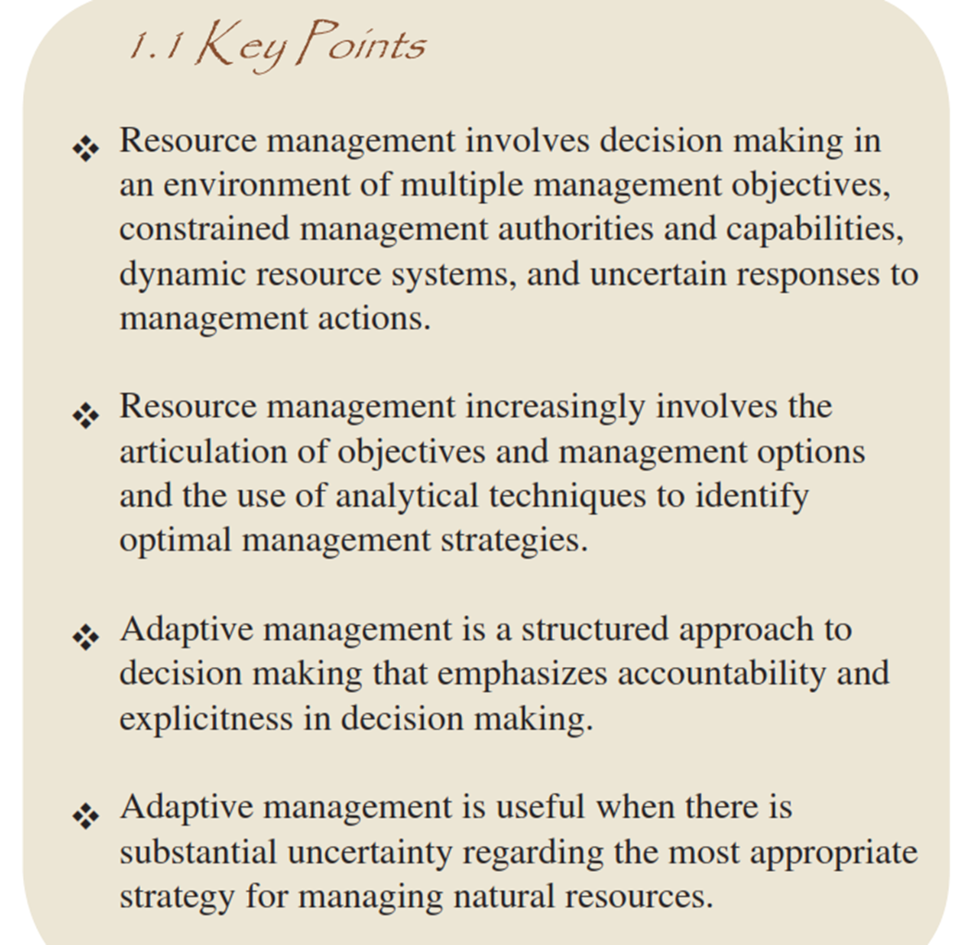
(William, et al 2009)

Slide 14
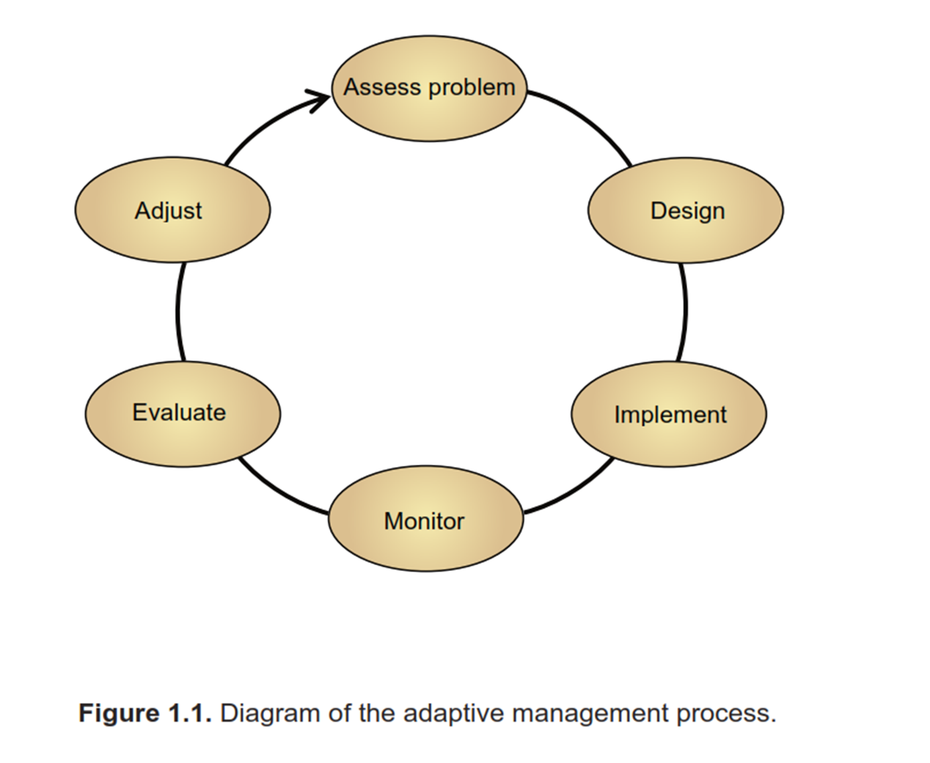
(William, et al 2009)

Slide 15
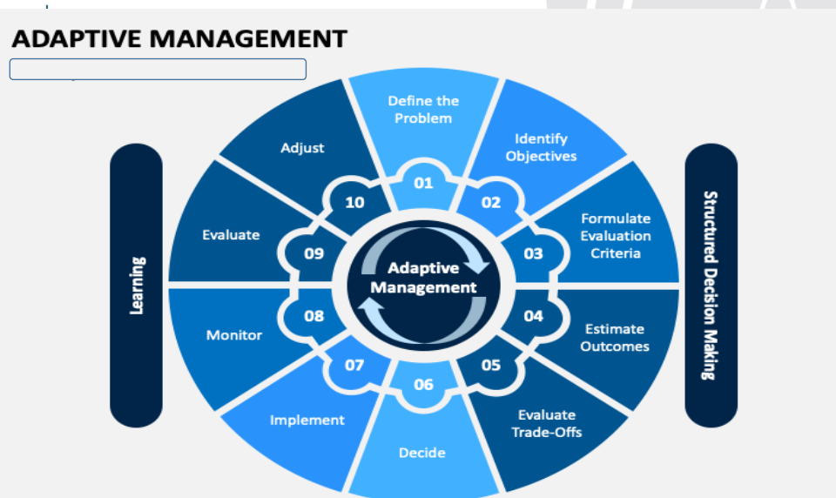

Slide 16
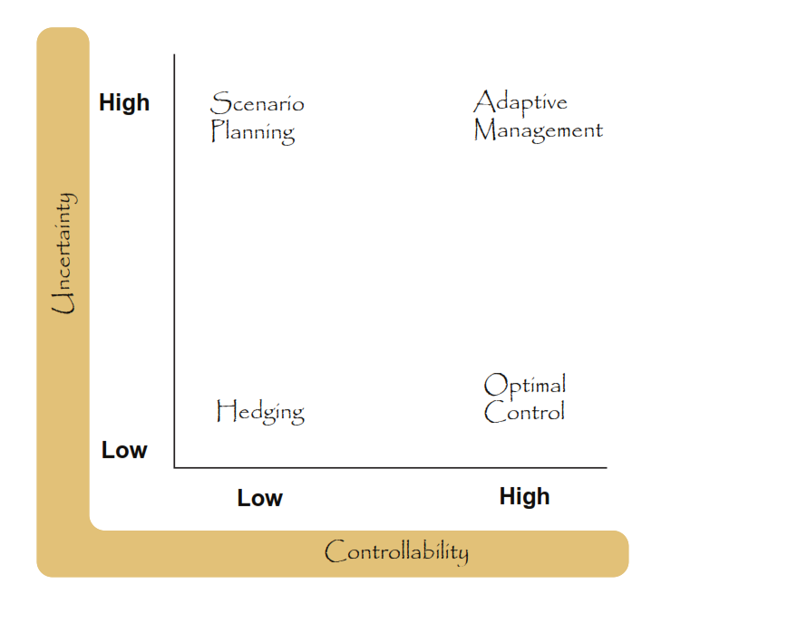
(William, et al 2009)

Slide 17
Prasyarat
Mandate to take action in facing uncertainties
Institutional capacity and commitment

Slide 18

When to implement?
1. There are consequential decisions to be made
2. When there is an opportunity to apply learning
3. The objectives of management are clear
4. The value of reducing uncertainties is high
5. Uncertainties can be expressed as a set of competing and testable
models
6. A monitoring system can be put in place with a reasonable
expectation to reduce uncertainties

Slide 19
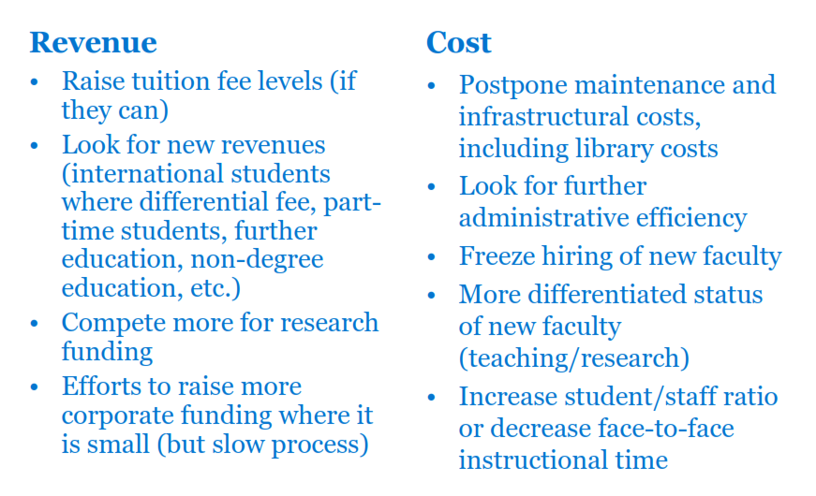
How does Institute respond?
(OECD, 2015)

Slide 20
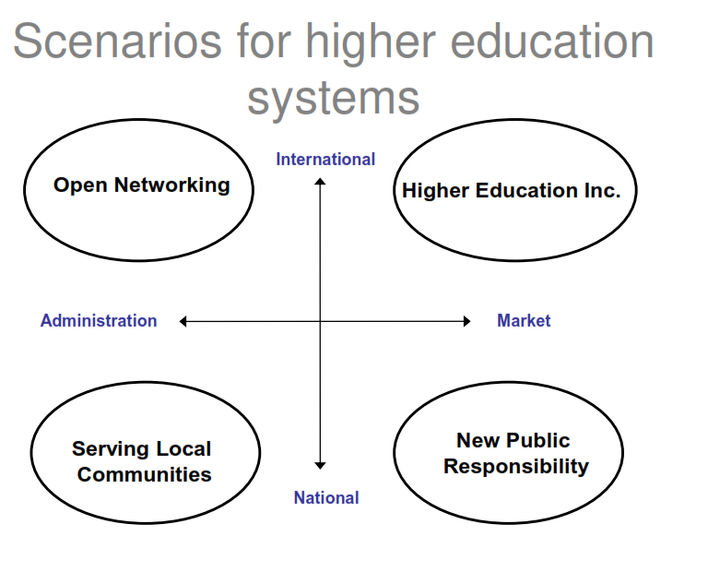
(OECD, 2015)

Slide 21
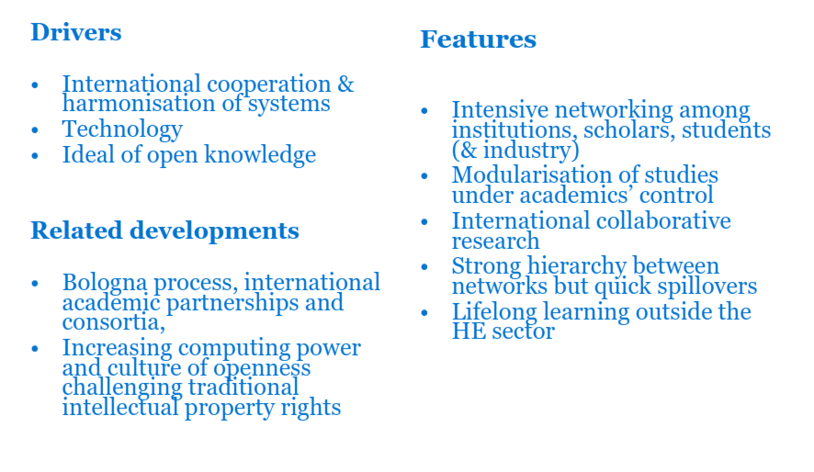
Scenario 1
(OECD, 2015)

Slide 22
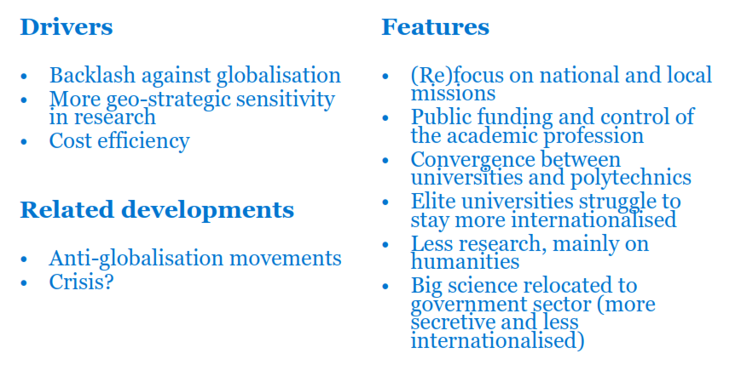
Scenario 2
(OECD, 2015)

Slide 23
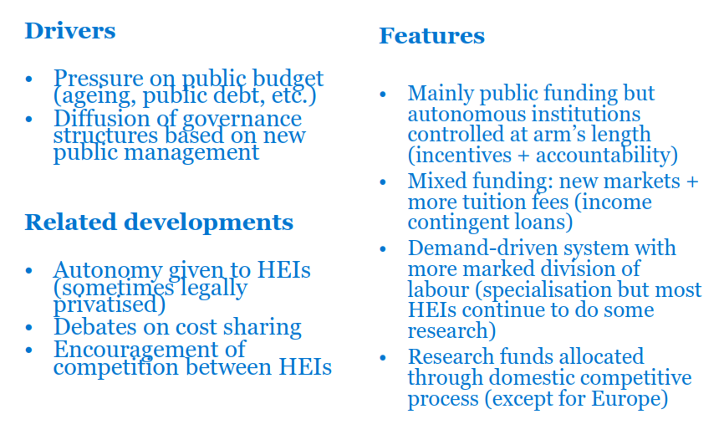
Scenario 3
(OECD, 2015)

Slide 24
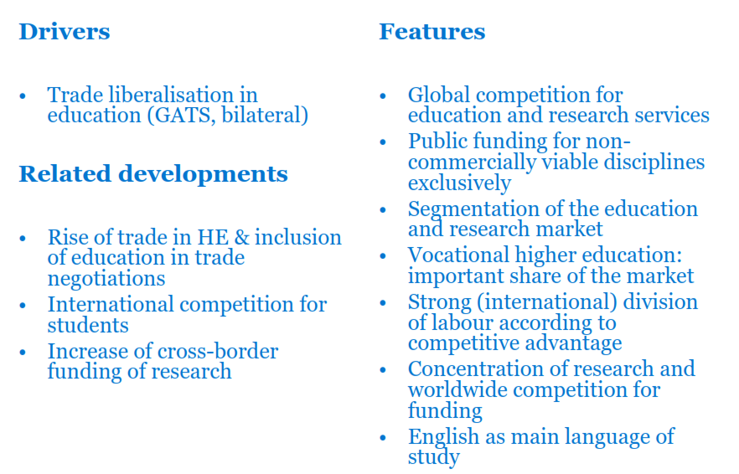
Higher Education Inc
(OECD, 2015)

Slide 25
References
Logli, C. (In press). “Higher Education in Indonesia: Contemporary Challenges in Governance, Access, and Quality.” In D. Neubauer, J. Hawkins, M. Lee, & C. Collins (Eds.), Handbook of Asian Higher Education. New York City, NY: Palgrave Macmillan.
OECD (2008). Four Future Scenarios of Higher Education. Centre for Educational Research and Innovation.
Williams, KB., Szaro, RC., Shapiro, CD. (2009) Adaptive Management: The US Department of Interior Technical Guide.Washington DC.
https://www.fierceeducation.com/pedagogy/future-higher-education-four-models-moving-toward-2030

Slide 26


